Slide 1


Slide 2
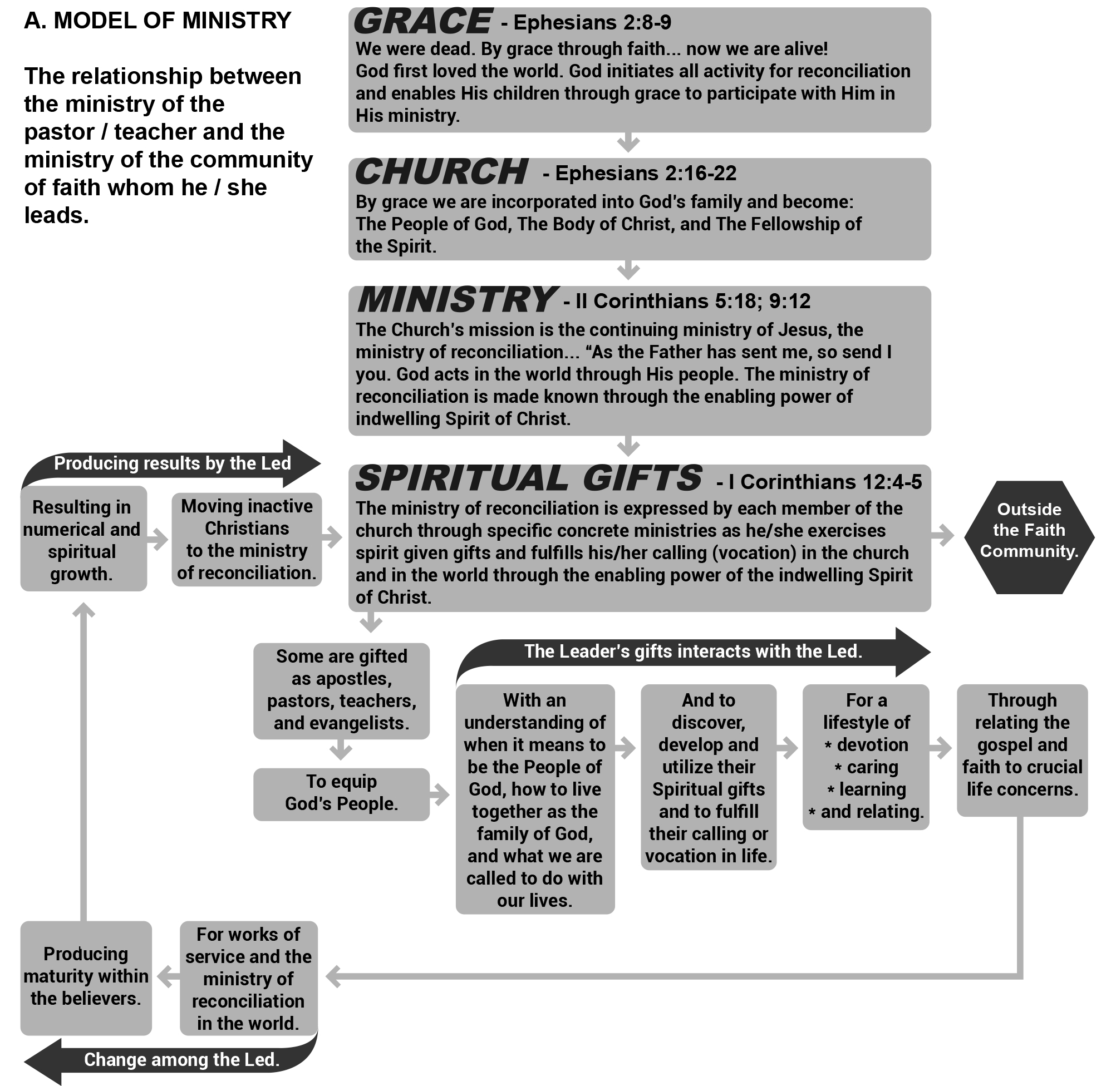
Notes:
(Figure 1.1) will summarize this discussion on ministry. It attempts to conceptualize the relationship of the leadership ministry of the pastor-teacher to the ministry of the People of God whom s/he serves.
Following Figure 1.1 full circle from Grace through the Leader interacting with the Led, through Change among the Led, finally through Producing Results by the Led, it becomes clear our ministry of leadership is to prepare others for their ministries. Do you notice how the Led then begin to be integrated into the “Ministry” portion of the sequence of events?

Slide 3
Christian Leadership - The transference of vision.
Who we are as the People of God;
(b) how we may live together as the family of God; and
(c) what we are called to do with our lives in the mission of God.

Slide 4
“Christian leadership is, I believe,
humble service to others
for the purpose of enabling them,
through example and teaching,
to live their lives under the Lordship of Christ
and to understand, accept, and fulfill
their ministry to each other
and their mission in the world.”
E.L.F.

Slide 5
Five Important Lessons…
1. Good and godly people differ and sometimes collide with the leader.
2. Many issues over which we experience conflict are culturally, ethnically, local community and family-based matters, and not a violation of scripture.
3. Differences that divide us have the power to alienate members of the body of Christ and to impact the work of God negatively in our communities.
4. Respecting those who differ with us is to love them, as God loves them.
5. Acceptance of others implies that we can learn from them.

Slide 6
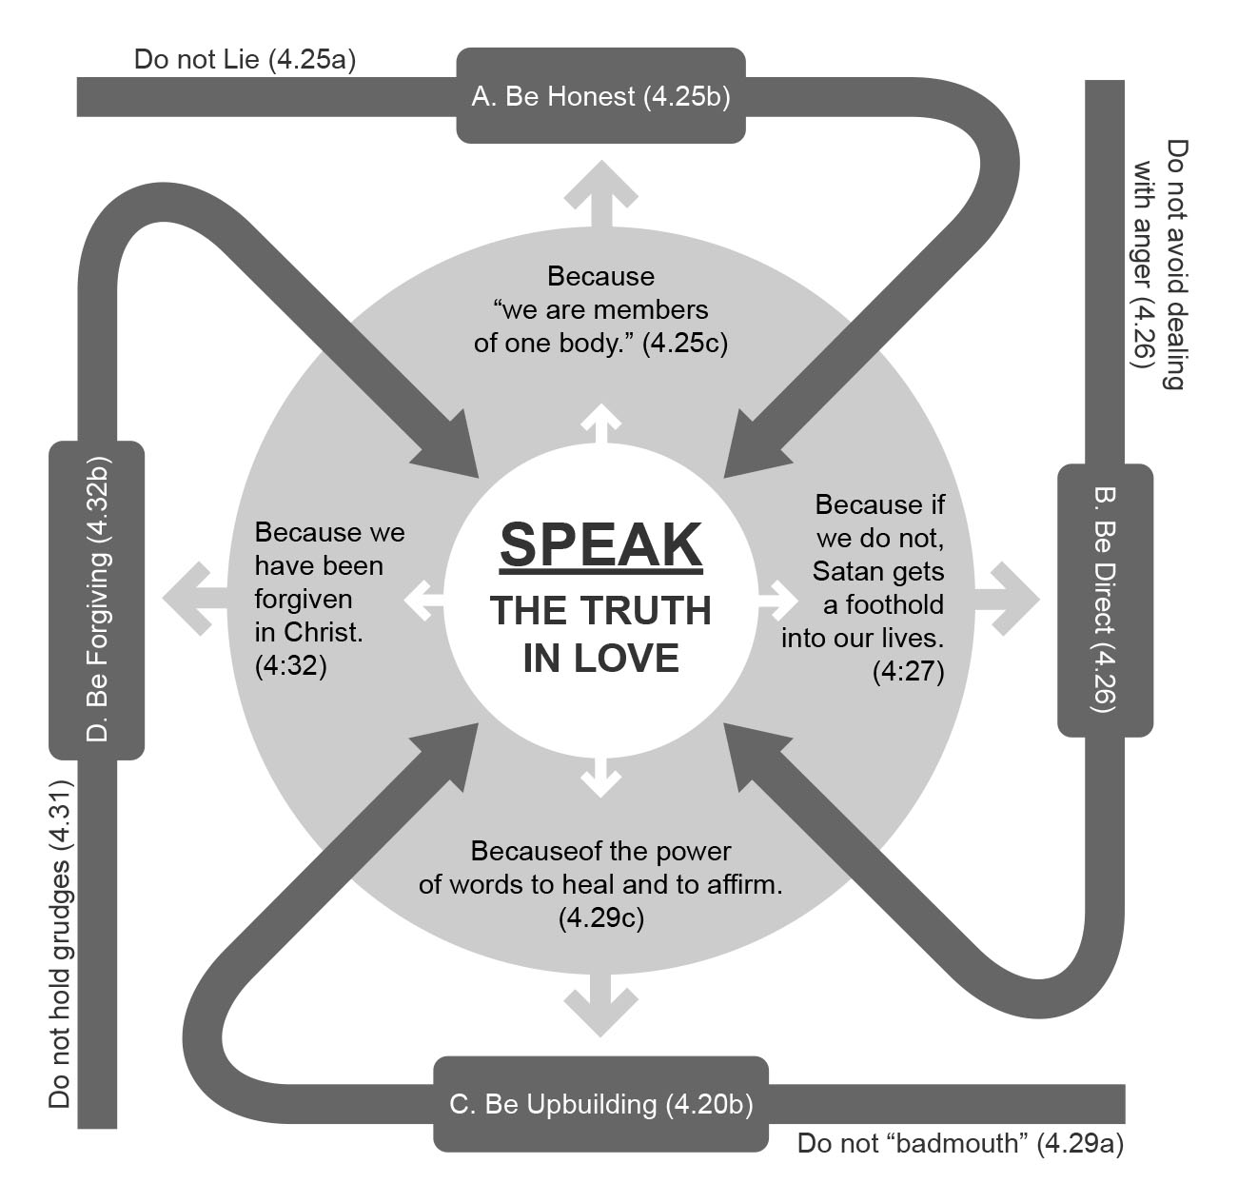
Notes:
“Communication is to leading what breathing is to living.”
Questions for Decisive Leaders in a Faith Community. !. 2. 3. 4. “Communication is the greatest single factor affecting one’s personal health and his relationship to others”
Over the years, Figure 2.1 has provided me a model for thinking about the powerful and grace-enabled impact and doing the hard and necessary work of pastoral conversation in the communities of faith where I have served.

Slide 7
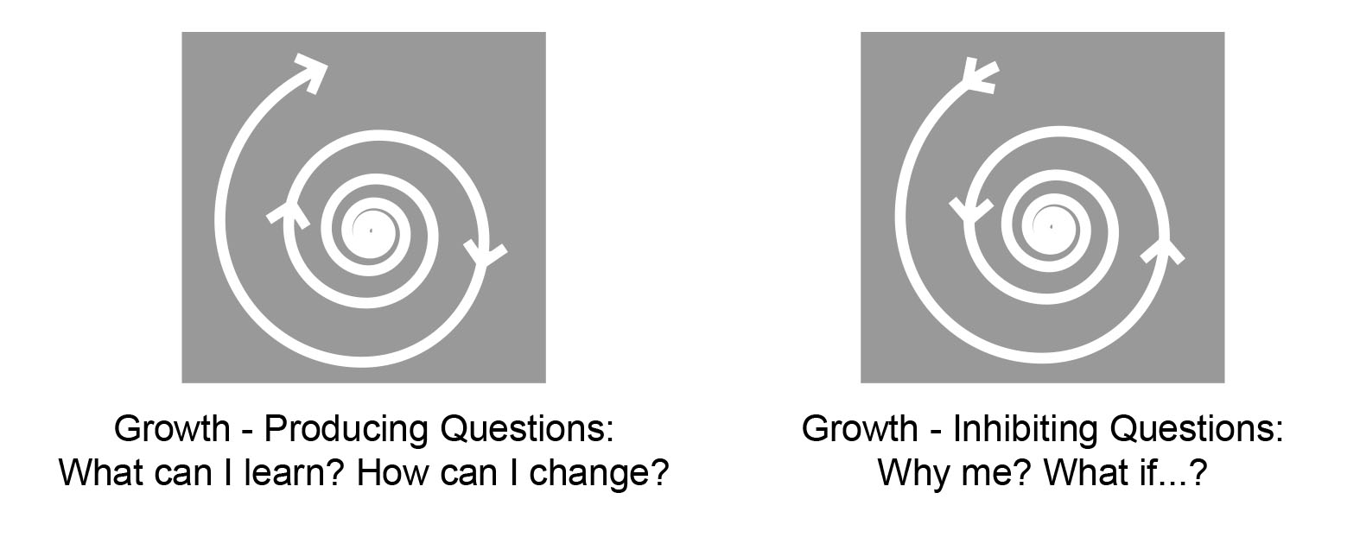
Notes:
Positive questions (see Figure 2.2) to ask in the midst of conflict situations are: What can I learn? How can I change? These are growth-producing questions. On the contrary, growth-inhibiting questions are: Why me? What if…? This is the could have, should have, would have way of thinking.

Slide 8
Consider these questions …
1. Does what I say build up or tear down the other person?
2. Would I say what I am saying directly to the person involved?
3. Do I know all the facts, or am I responding on the basis of half-truths or partial facts?
4. Is my response triggered more by emotion than by reason?
5. Is the issue really deserving of the action and energy that I am giving it?
6. Can the situation be seen from a different perspective?
7. Have I tried to accept the feelings of the other person and understand why the person feels the way s/he does?

Slide 9

Notes:
Look at A, then relate A with its implications for B. Nouwen’s work underscored the iterative aspect of A, showing that we play a role in activating the power God offers us. As leaders, dealing with A and B becomes a collaborative and trust-filled relationship. Although the Power involved in leading the people of God may appear to reside mostly in area B, in fact, the Power comes from Christ as shown in A; and this power from Christ is something we as leaders are continually receiving, reflecting, and pursuing, hence the circular diagram. Your leadership style is a reflection of how you respond to the power (B) Christ offers you. Most of this chapter explores area B; however, it is essential to take a moment to explore the source of the leader’s strength to speak to, not past, each other.

Slide 10
FIRST THINGS FIRST
BEFORE proceeding with equipping issues, let’s pause, review, and discuss God’s supreme “goal” or purpose for His children.
God’s vision for us: "You ought to live holy and godly lives” (II Peter 3:11-12 NIV).
Seven questions for Christian character development
1. Will this action strengthen me spiritually?
2. Would I want my child, spouse, or best friend to copy this action of mine?
3. Does this action violate a biblical principle?
4. Does the is action strengthen the body of Christ?
5. Would an unbelieving friend be attracted to Christ and faith by my behavior?
6. Do my negative attitudes affect other people?
7. If this happens, what will I do to change this type of behavior in my life?

Slide 11
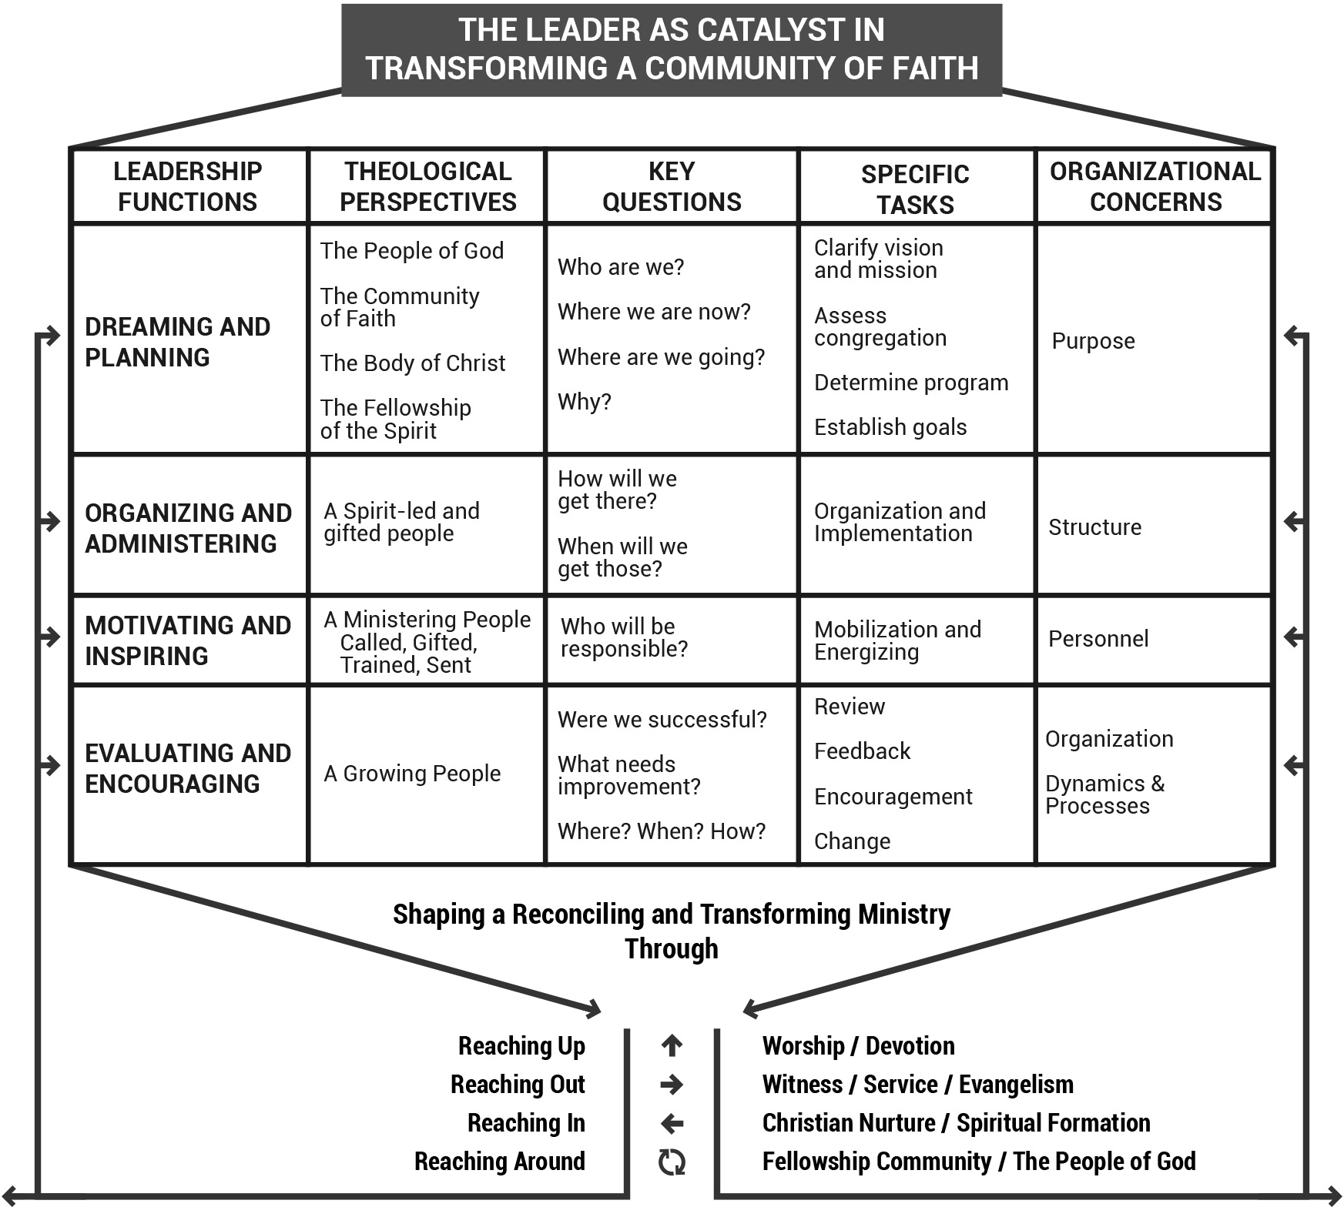
Notes:
Ephesians 4:11-16 enunciates such a model. The passage outlines a model for us as Christian leaders in our passion to equip the people we lead for a lifestyle of service.
The context...is "God's people" (Ephesians 4:11-12). The key focus is participation. The task...is to "prepare God's people" (Ephesians 4:12). The key idea is formation. The purpose…is transformation for a "holiness lifestyle" (Ephesians 4:13). The key issue is Christ-likeness. The goal...is "works of service" (Ephesians 4:12). The key thought is expression. The dynamic...is "love within the Body of Christ" (Ephesians 4:15-16). The key concept is interaction. The Primary Method of teaching for transformation, I believe, is modeling or “exampling.”

Slide 12
Establishing Growth Goals for Ministry and Mission.
At a very basic level, specific GOALS should:
Be measurable.
2. Be relevant.
3. Be attainable.
4. Contain an action verb.
5. Include a deadline.
GROWTH GOALS are statements of faith for the Christian leader that express clearly what we believe God will do through us.

Slide 13
Leaders Who Make Things Happen
1 … are "deciders" rather than “drifters."
2 … know where they are going and how they are going to get there.
3 … are results - oriented and not activity-oriented.
4 … are among the small percentage who write down their growth goals.
5 … develop a mission statement as the foundation upon which every ministry of the district, region, or institution is built or evaluated.
6 … are dreamers who dream great dreams!
7 … understand leadership as the transference of vision!
8 … think big and dare to aim high by establishing growth goals that are measurable, feasible, attainable, and that have an action verb and a deadline.
9 … do not stop with writing down growth goals. They work hard at detailing programs and plans by which the goals will be reached.
10 … expect great things from God and attempt great things for God. They work as if it all depended on them and pray as if it all depended on God!

Slide 15
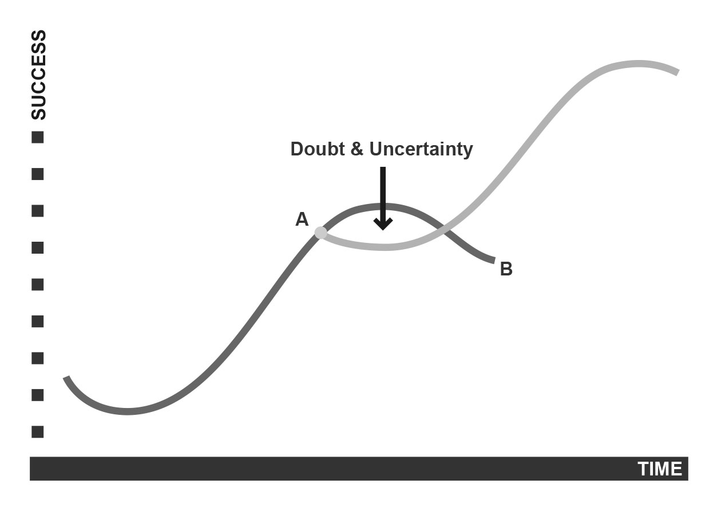

Slide 16
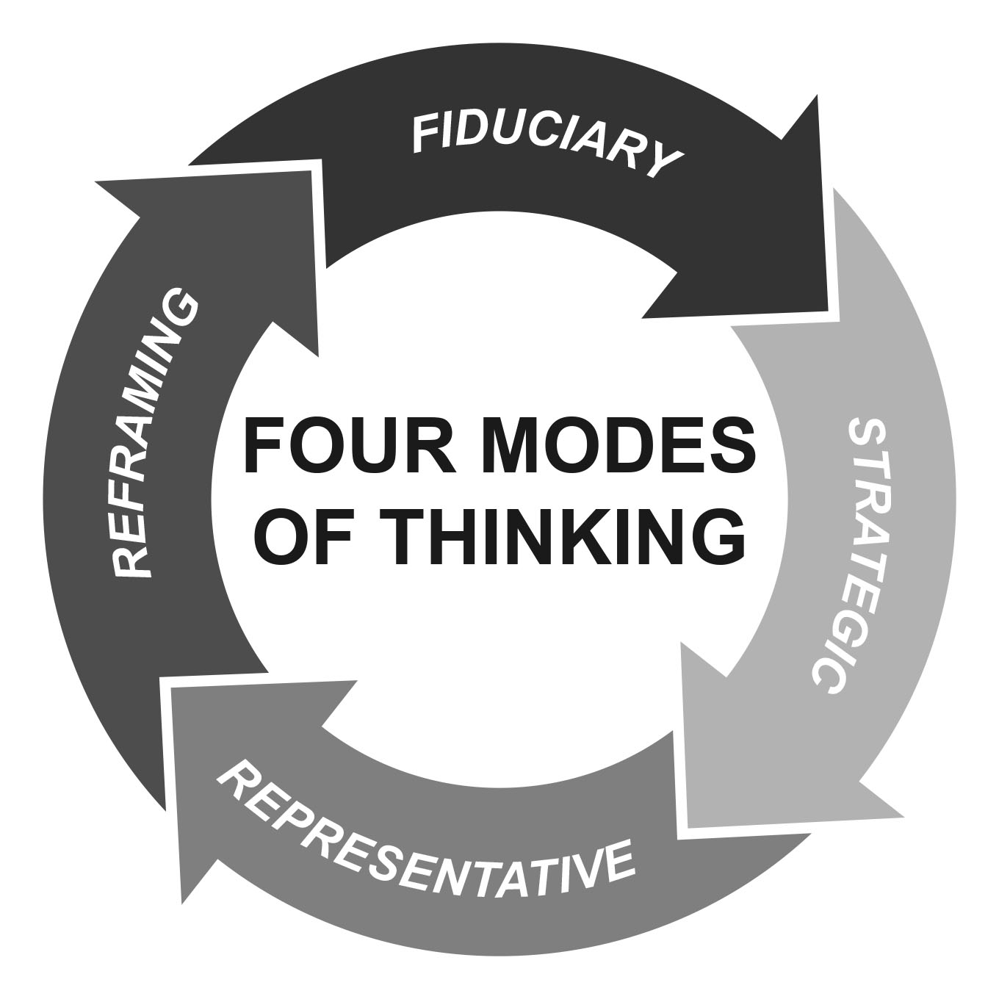

Slide 17
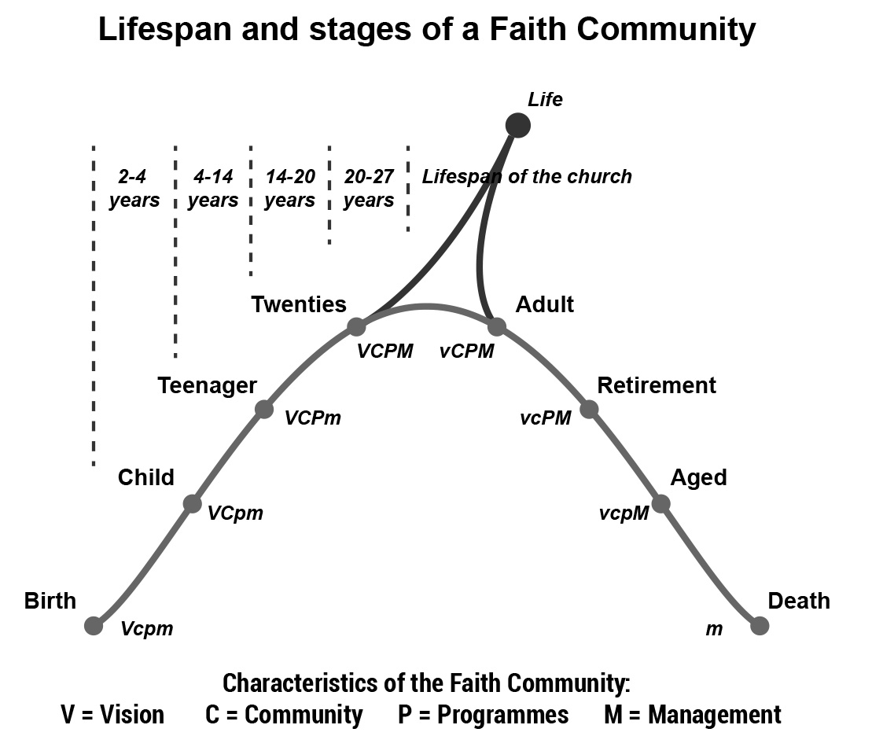

Slide 18
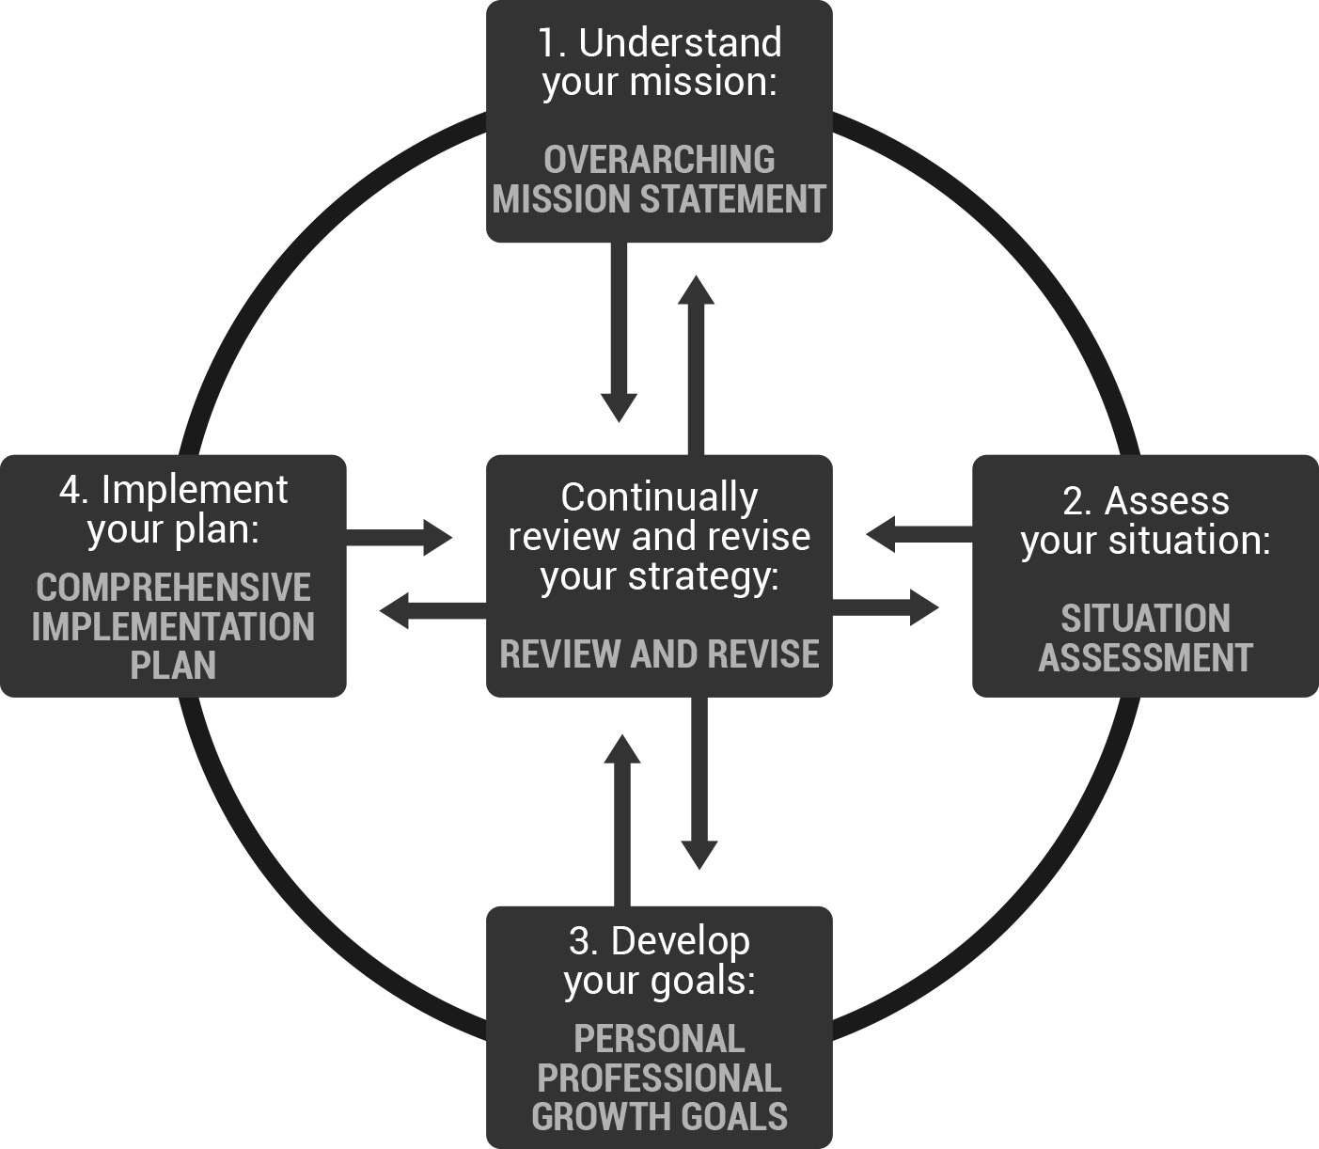

Slide 19
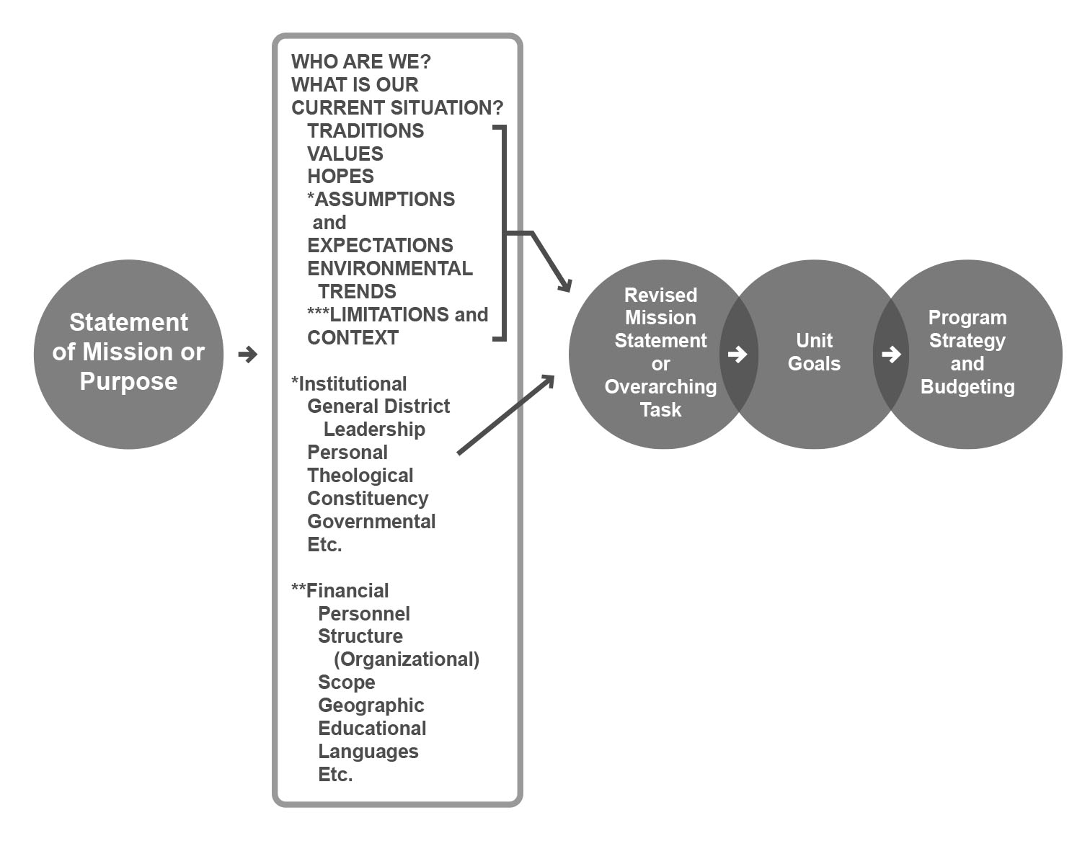

Slide 20
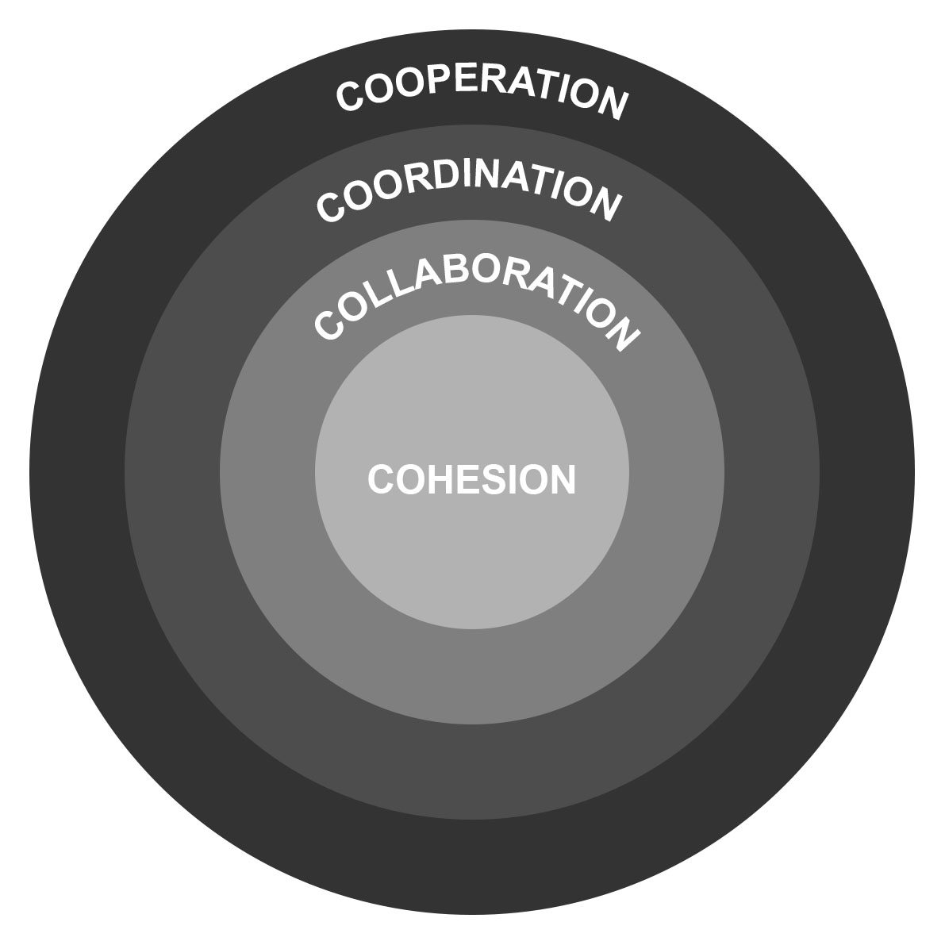

Slide 21
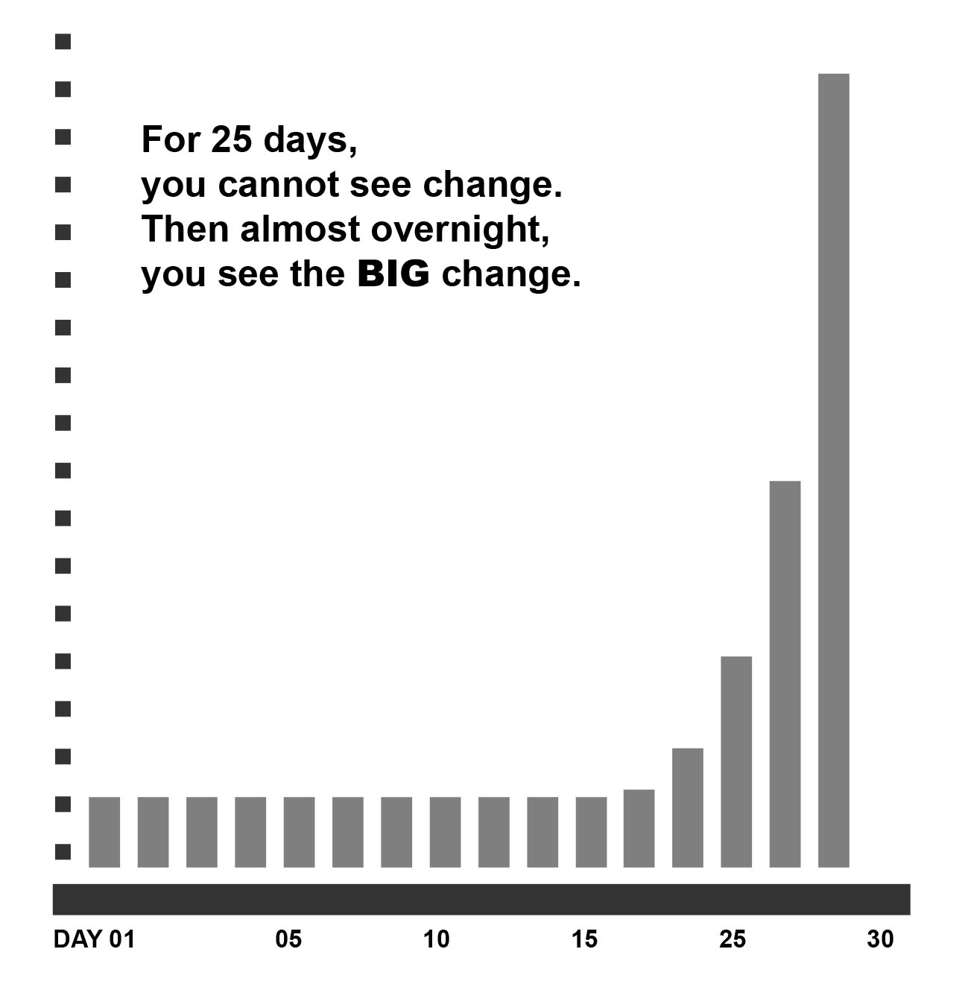

Slide 22


Slide 23


Slide 24


Slide 25
